Slide 1


Pizza Sales analysis
Using MySQL
MENTORNESS INTERNSHIP PROJECT BY
KRISHNA VAGHELA

Slide 2
CONTENTS
Project Overview
Dataset Description
Data Exploration and analysis

Slide 3
PROJECT OVERVIWE
In this project, I use MySQL to analyze pizza sales dataset, extracting valuable insights into customer behavior, popular pizza types, sales trends, and overall performance.
This analysis is based on four tables: order_details, orders, pizza_type, and pizza.”

Slide 4
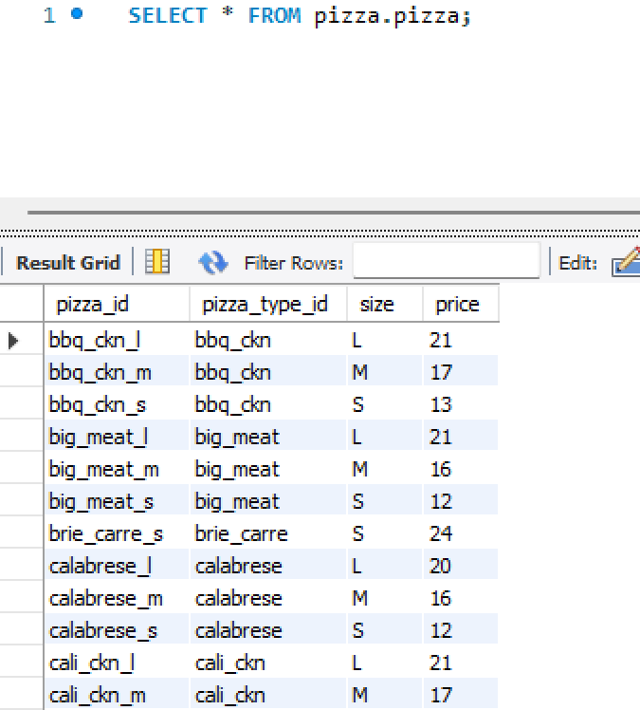
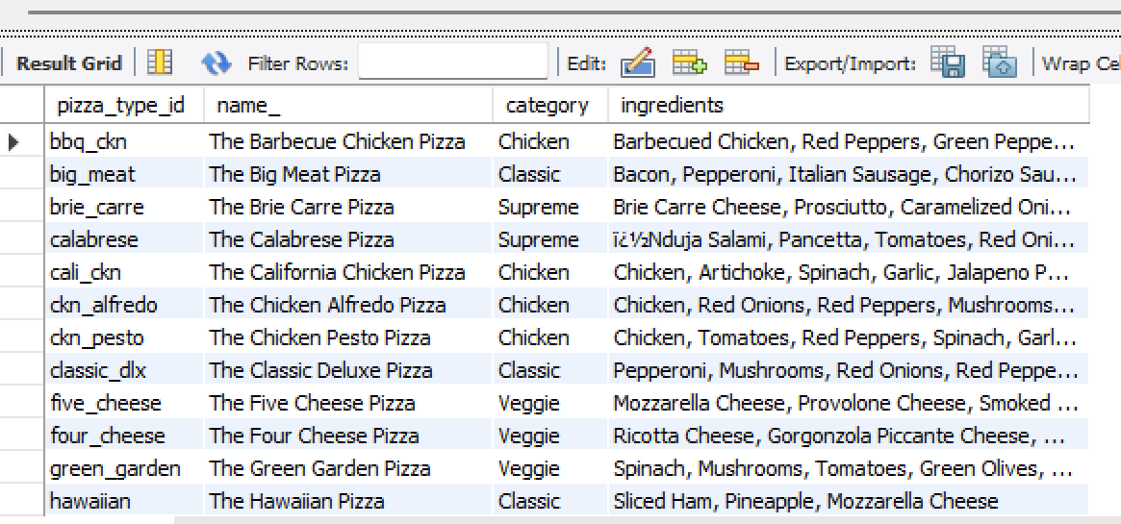
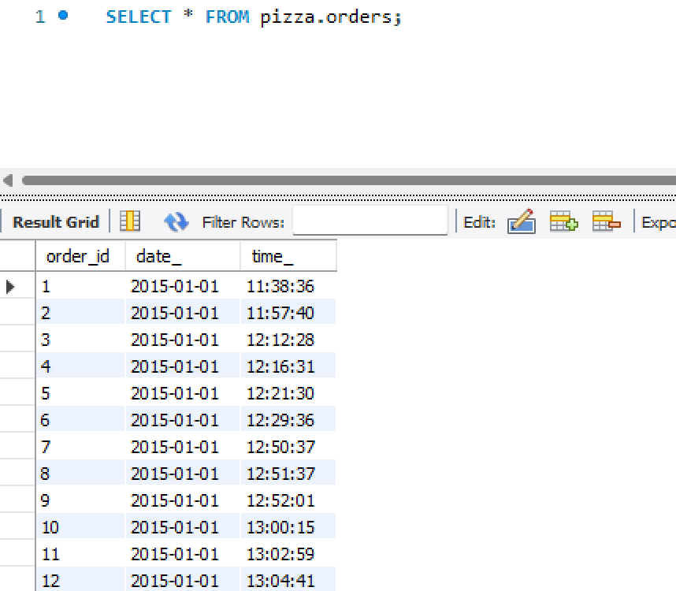
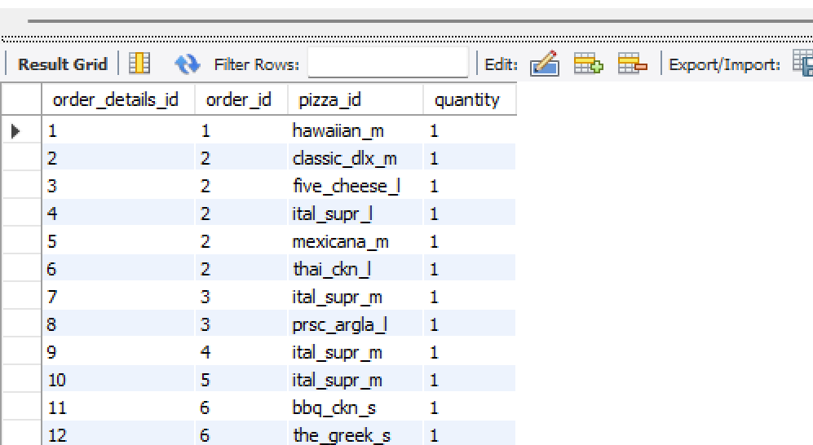
Pizza
Pizza_type
Orders
Order_details

Slide 5
Dataset:
1. order_details
• order_details_id: Unique identifier for the order detail.
• order_id: Identifier linking to the orders table.
• pizza_id: Identifier linking to the pizza table.
• quantity: Number of pizzas ordered.
2. orders
• order_id: Unique identifier for the order.
• date: Date the order was placed.
• time: Time the order was placed.
3. pizza_type
• pizza_type_id: Unique identifier for the pizza type.
• name: Name of the pizza.
• category: Category of the pizza (e.g., vegetarian, meat, etc.).
• ingredients: List of ingredients used in the pizza.
4. pizza
• pizza_id: Unique identifier for the pizza.
• pizza_type_id: Identifier linking to the pizza_type table.
• size: Size of the pizza (e.g., small, medium, large).
• price: Price of the pizza.

Slide 6
DATA ANALYSIS

Slide 7
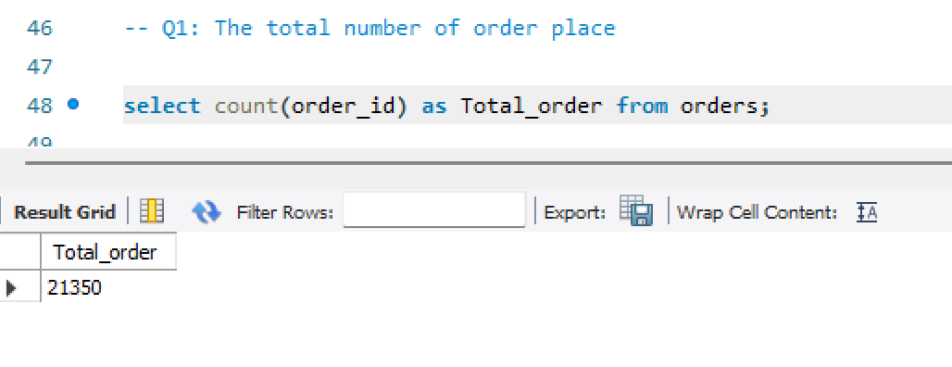

Slide 8
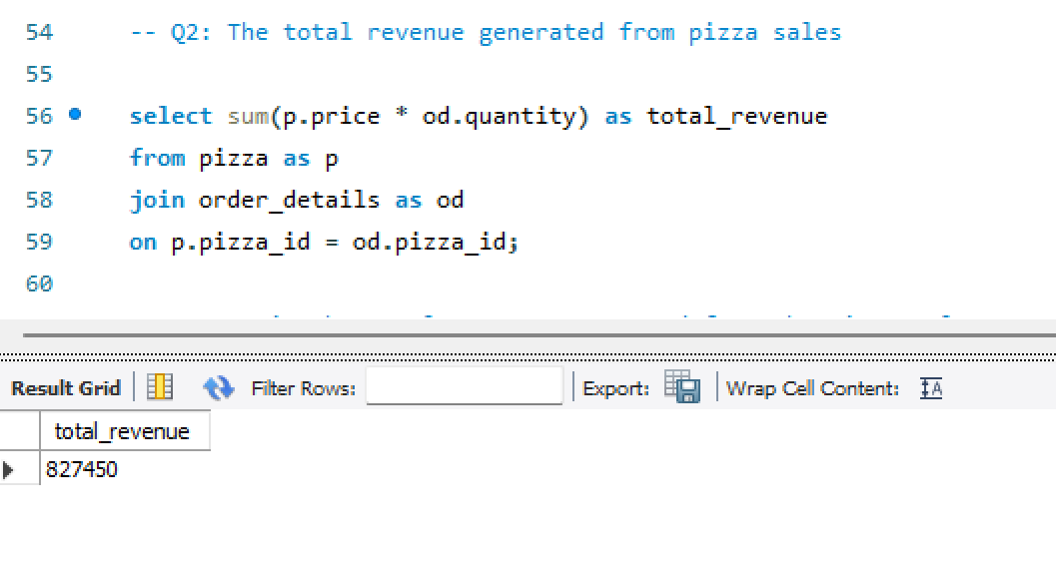

Slide 9
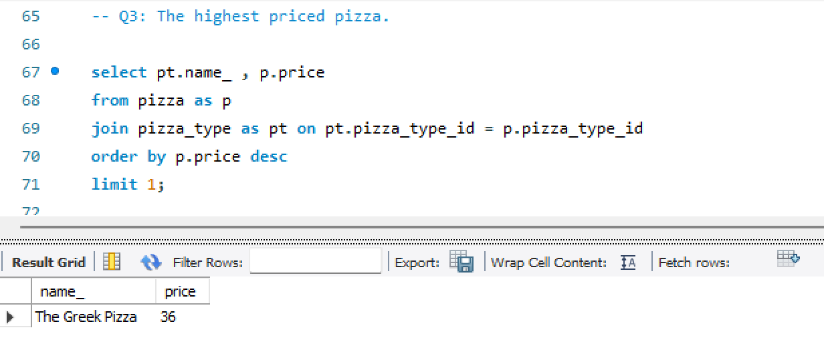

Slide 10
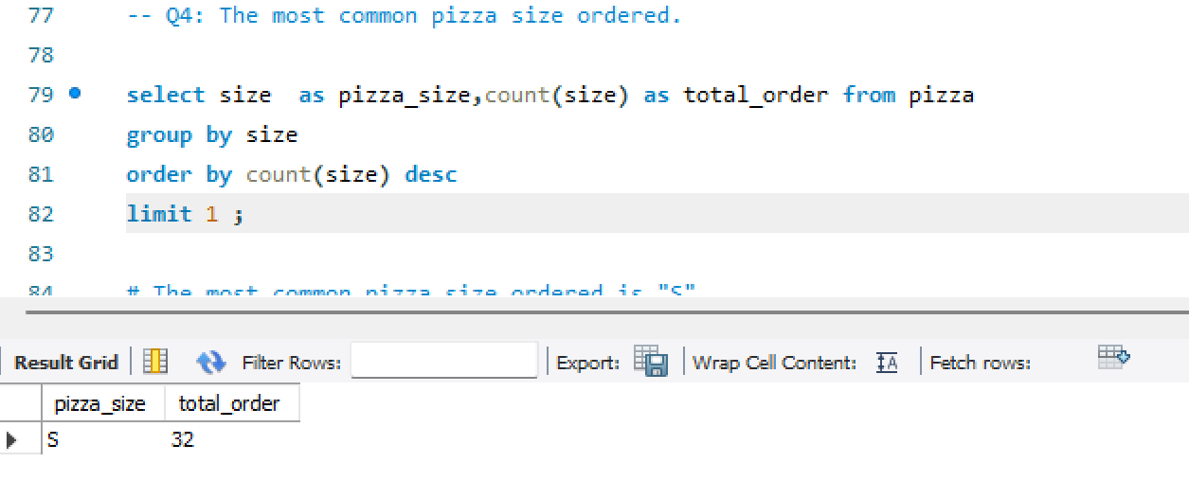

Slide 11
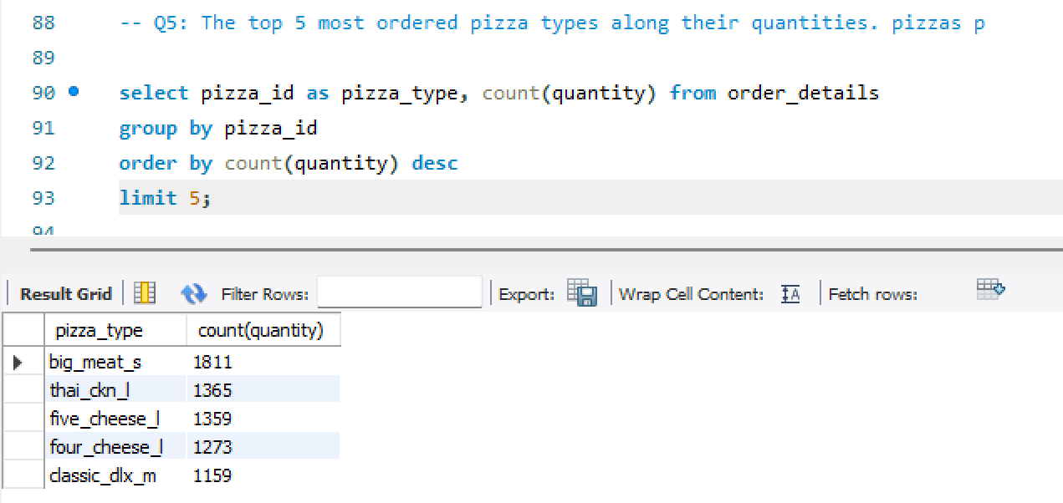

Slide 12
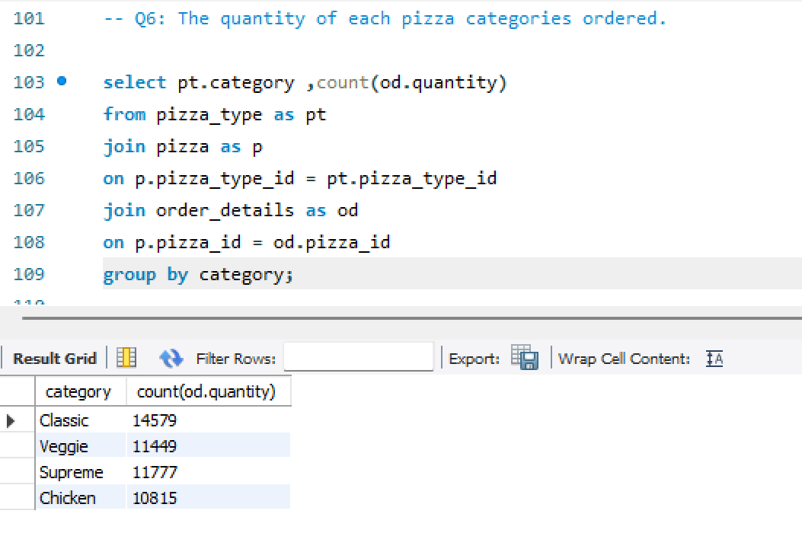

Slide 13
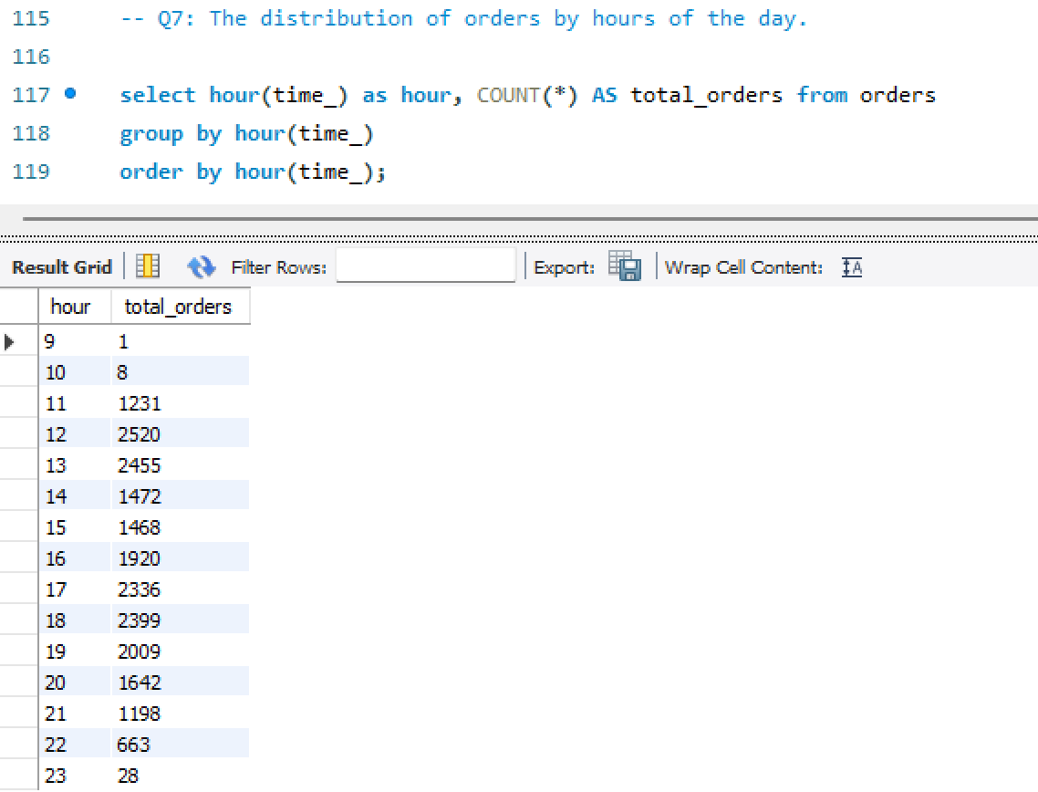

Slide 14
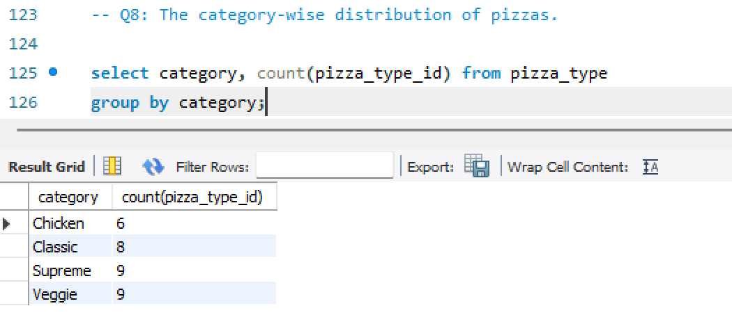

Slide 15
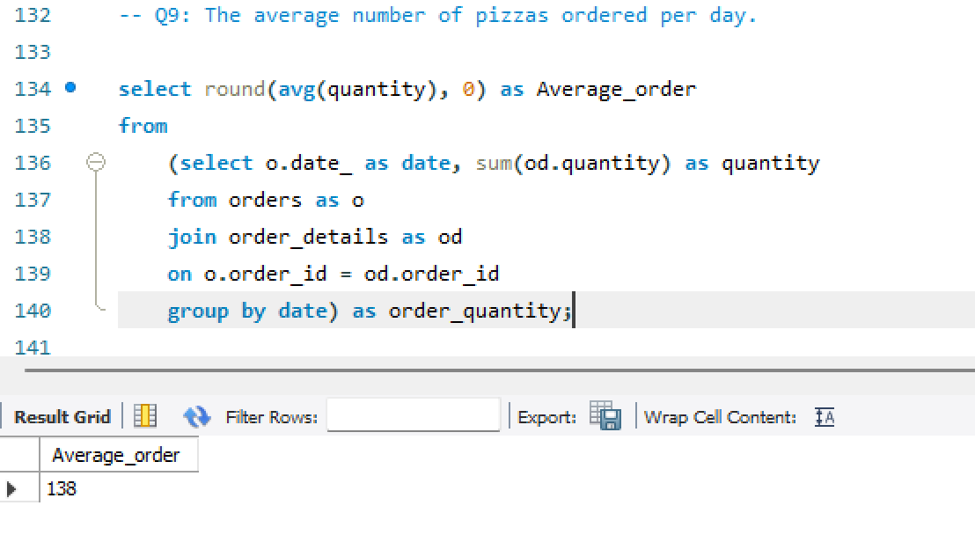

Slide 16
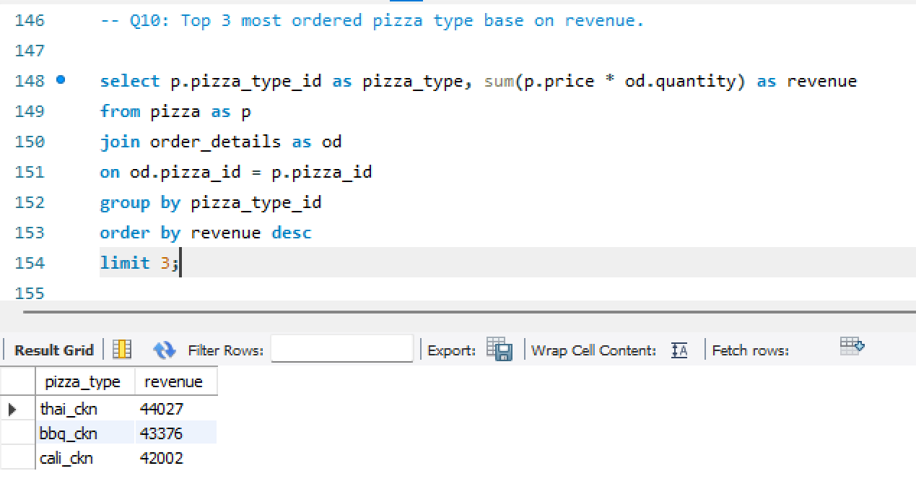

Slide 17
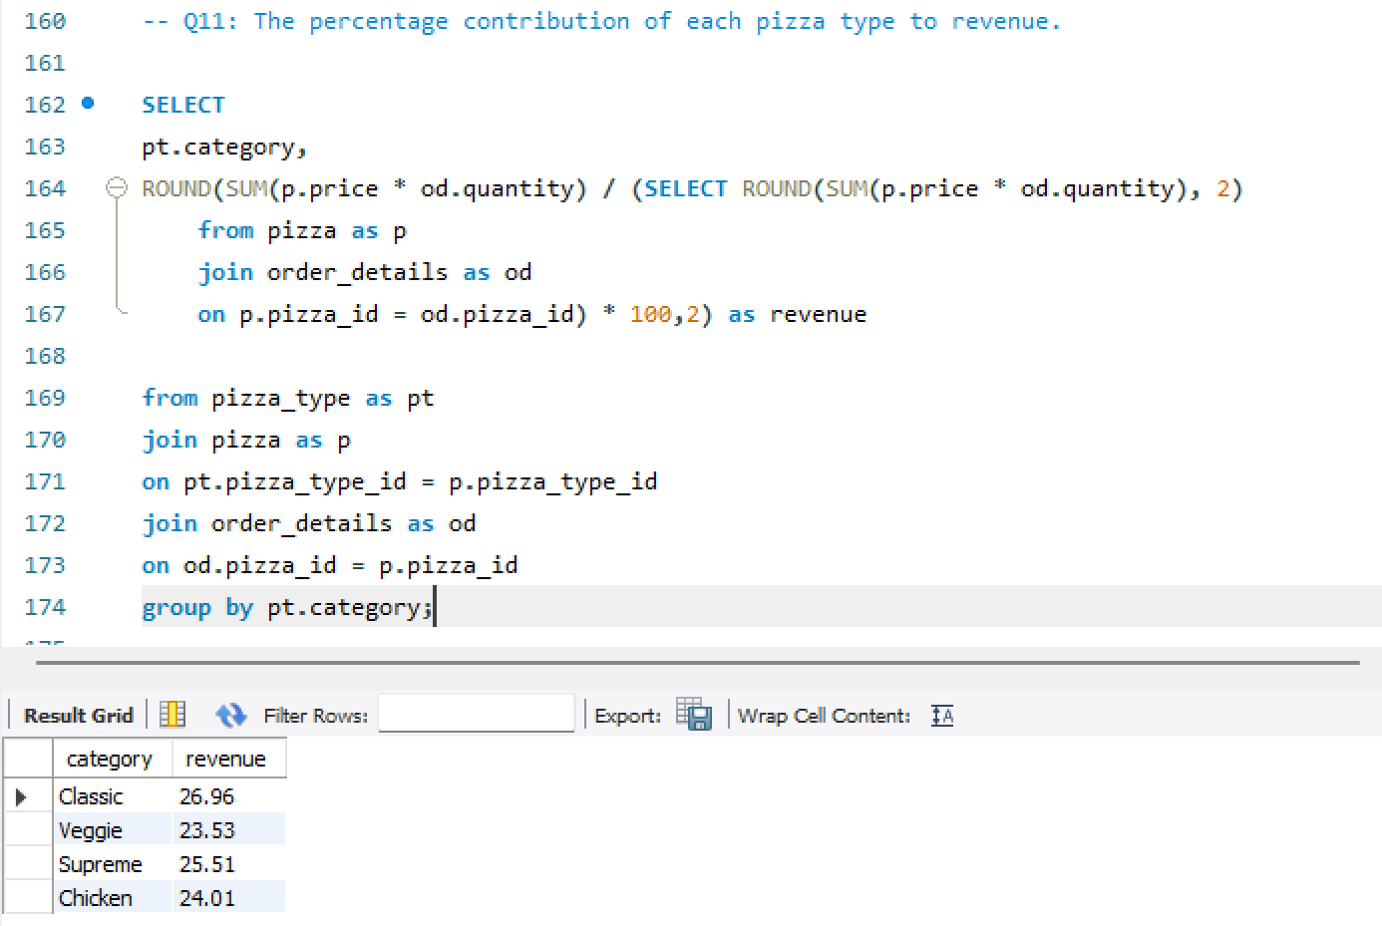

Slide 18
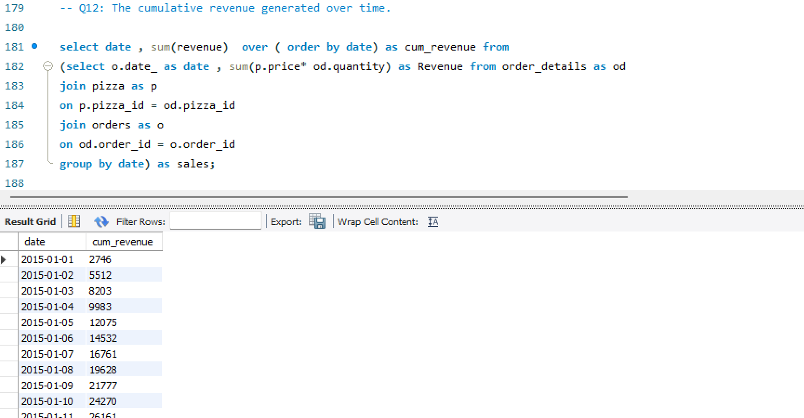

Slide 19
